Slide 1

Data Science and Machine Learning
Algorithms Explained

Slide 2
Ordinary Least Square Regressions (OLSR)
OLSR is a common algorithm for predicting the dependent variable value based on known values.
We are looking for a relationship between an independent variable and a dependent one, so that we can predict the dependent variable value even when we don’t have data for specific independent variable value.
An example is estimating how tall someone is by their hand size. If we sample some data by measuring both hand size and height for a group of individuals, we can than predict how tall someone is by knowing their hand size.

Slide 3
Raw Data
Y | X
23 | 15
31 | 19
35 | 17
41 | 23
50 | 23
51 | 30
55 | 32
This is a random data set. Y is the dependent data, and X is the independent data.

Slide 4
OLSR Algorithm
The algorithm is based on the idea that we can draw a line through the data that represents the general relationship between the points. In Excel we can just add a trend line to see this.
Excel masks us from the math, but let’s take a look at what is really happening to find this line.

Slide 5
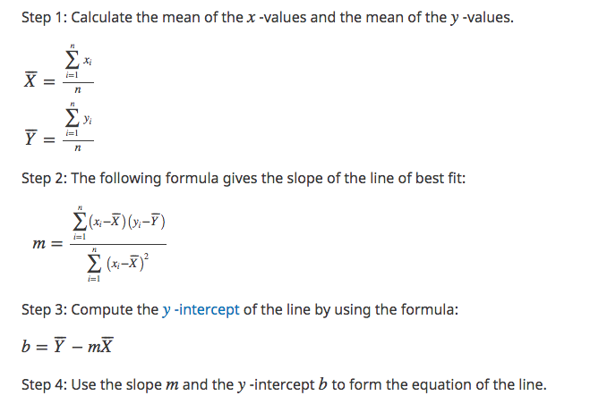
The Math
Y | X
23 | 15
31 | 19
35 | 17
41 | 23
50 | 23
51 | 30
55 | 32
The trend line is represented by the formula
Y = mX + b,
Y is our dependent variable and X is our independent variable.
m is an estimate of the slope of the trend line.
b is the “Y intercept”, meaning it is the value for Y when X = 0, the point where the line would intersect with the Y axis in our graph.

Slide 6
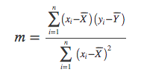

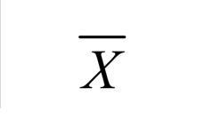

The Math Explained
The scientists like to make the formulas look very complex but the math really isn’t that difficult at all.
Is the symbol for sum
Is the symbol for “mean” or average. We see both the X and Y with a line over it. We insert the average for all known X and Y values where we see this in the formula.
Just means: calculate the average of all of the X values. Get the sum and divide by the number of values.

Slide 7
The Math Explained
The standard calculation for the slope of a line is to calculate the change in Y by the change in X for two points on the line.
Since we don’t have actual points on the line (we are trying to find the line), we use total variance between the points and the averages of all the points. X – the average of X times Y – the average of Y. That represents the change in Y and we square the variance of X to represent the change of X in the scope equation. This use of squares is why the algorithm is called Ordinary Least Square Regression. We want the line to represent the smallest total distance between each of the points of known data.

Slide 8
”Least Squares” Visualized
The bigger the squares the less accurate the trend line is.
In our data, we have one point that is basically on the line, and one that is a noticeable outlier.

Slide 9
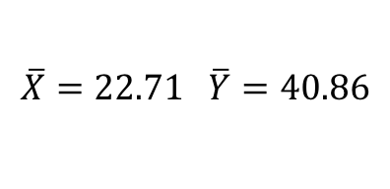
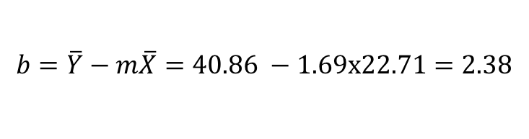
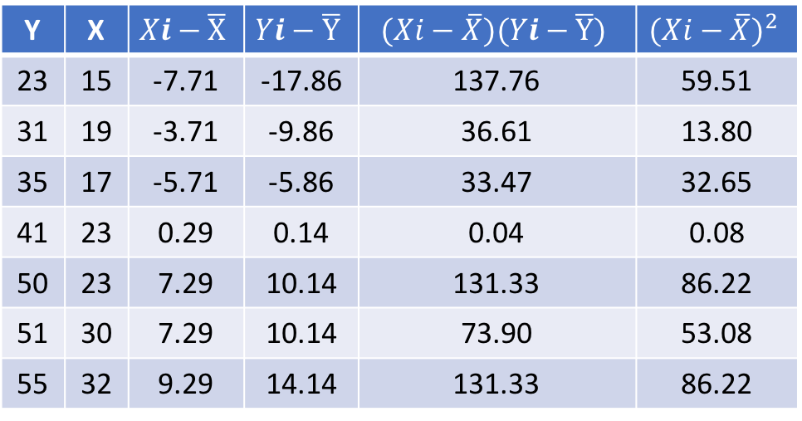


Plugging the Numbers In
Y | X | $$Xi−\overline{X}$$ | $$Yi−\overline{Y}$$ | $$(Xi−\overline{X})(Yi−\overline{Y})$$ | $${(Xi−\overline{X})}^{2}$$
23 | 15 | -7.71 | -17.86 | 137.76 | 59.51
31 | 19 | -3.71 | -9.86 | 36.61 | 13.80
35 | 17 | -5.71 | -5.86 | 33.47 | 32.65
41 | 23 | 0.29 | 0.14 | 0.04 | 0.08
50 | 23 | 7.29 | 10.14 | 131.33 | 86.22
51 | 30 | 7.29 | 10.14 | 73.90 | 53.08
55 | 32 | 9.29 | 14.14 | 131.33 | 86.22
m $=\frac{\sum_{i=1}^{n}{(x−\overline{X})(y−\overline{Y})}}{\sum_{i=1}^{n}{{(x−\overline{X})}^{2}}}=\frac{415.71}{245.43} =1.69$
$$b=\overline{Y}−m\overline{X}=40.86 −1.69x22.71=2.38$$
Now that we know m = 1.69 & b = 2.38 we can estimate a value for Y for any new X.
$$Y=mX+b$$
$$\overline{X}=22.71 \overline{Y}=40.86$$
= 415.71
= 245.43
If X = 20, Y can be estimated as 36.26 because:
(1.69x20) + 2.38 = 36.26

